Slide 1

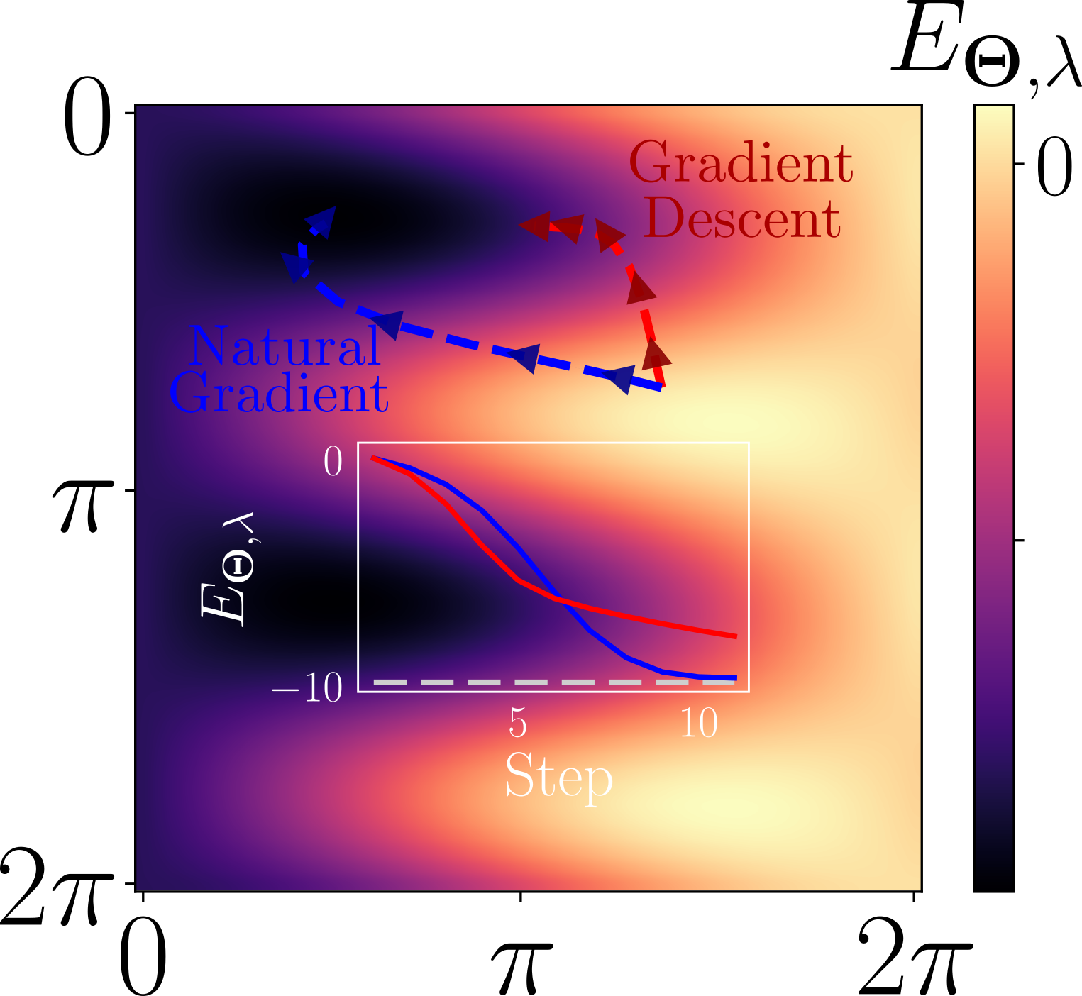
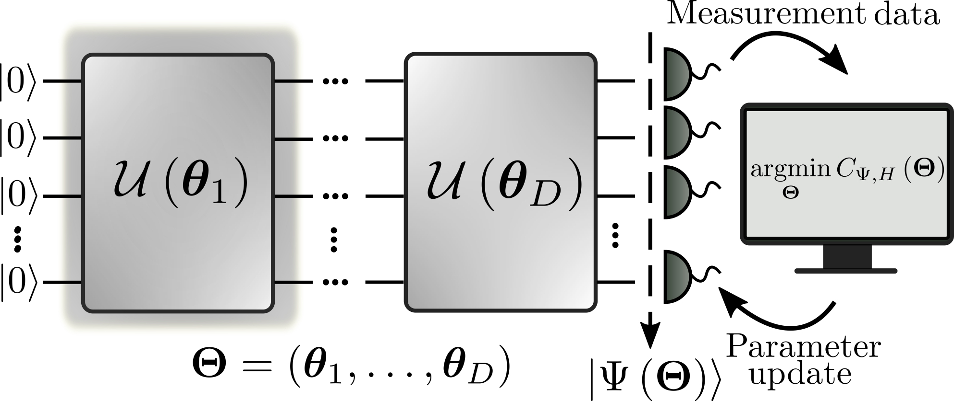



The Variational Quantum Simulation Toolbox
Cristian Tabares
Crash Course Seminar – 08/11/23
@T_L_Cris
cristiantabares.xyz
cristian.tabares@csic.es

Slide 2
Overview
Variational Quantum Simulation: why and how?
Proposed as tool to get the most of current quantum simulators
The optimization is difficult (barren plateaus and local minima)
Some workarounds: natural gradients and variational recompilation
Hands on workshop
Natural gradients with Pennylane
Improving the simulations with tensor networks

Slide 3
Overview
Variational Quantum Simulation: why and how?
Proposed as tool to get the most of current quantum simulators
The optimization is difficult (barren plateaus and local minima)
Some workarounds: natural gradients and variational recompilation
Hands on workshop
Natural gradients with Pennylane
Improving the simulations with tensor networks

Slide 4
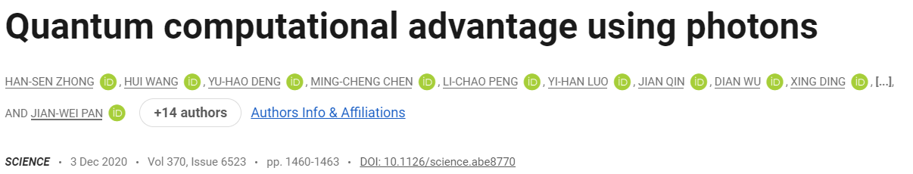
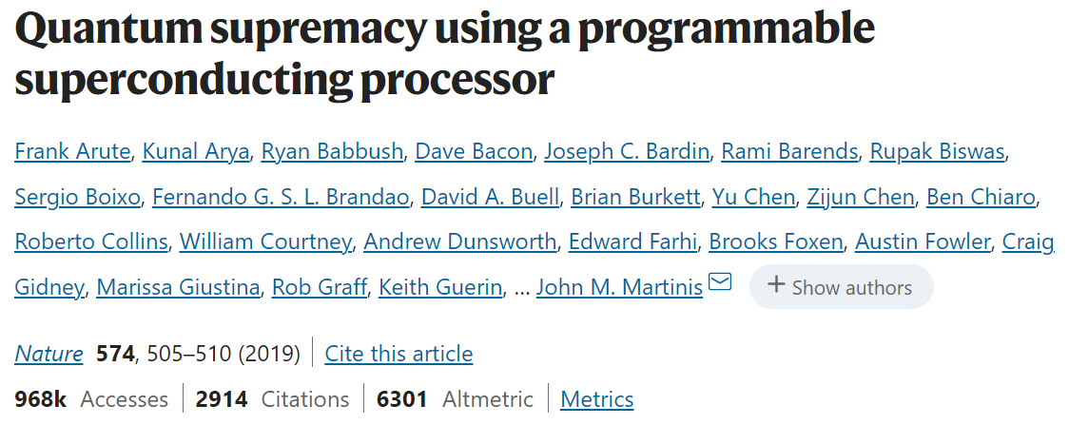
Variational Quantum Simulation: why?
Quantum simulators are controllable quantum systems used to simulate or emulate other quantum systems.
Georgescu et al., Rev. Mod. Phys. 86, 153 (2014)
A path to solve problems intractable for current supercomputers: quantum advantage?
Although already obtained, it was only for specifically tailored tasks
Is it possible to obtain a practical quantum advantage?

Slide 5
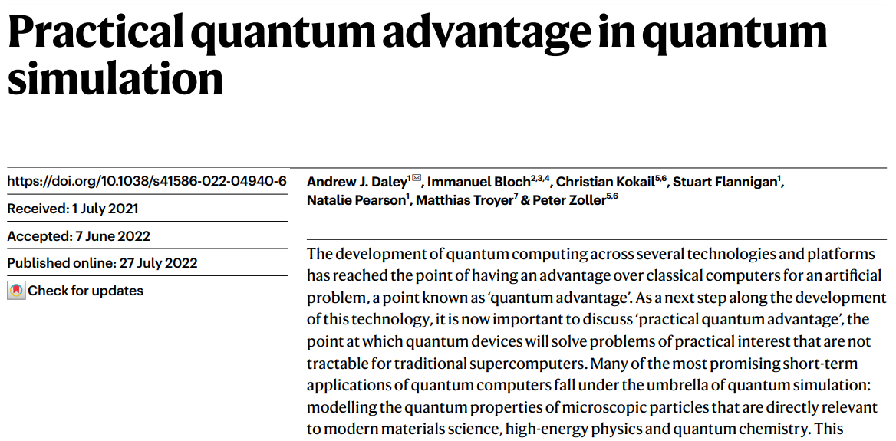
Variational Quantum Simulation: why?
Quantum simulators are expected to solve interesting problems intractable for current supercomputers: practical quantum advantage.

Slide 6
Variational Quantum Simulation: why?
Quantum simulators are expected to solve interesting problems intractable for current supercomputers: practical quantum advantage.

Slide 7
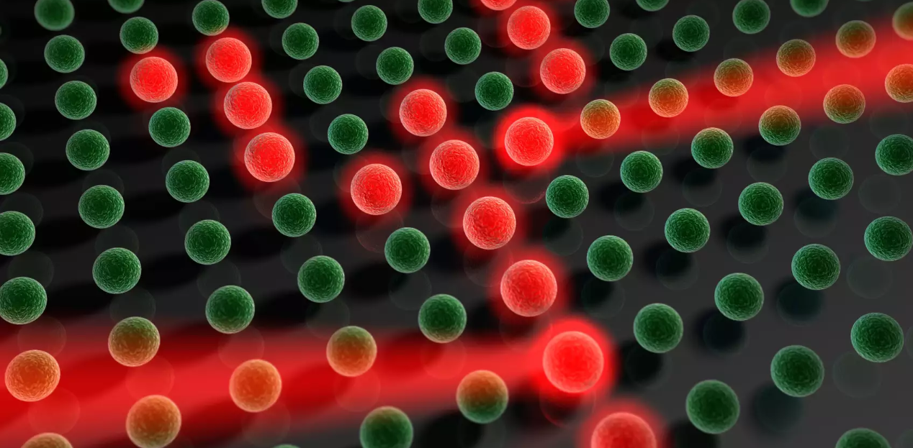
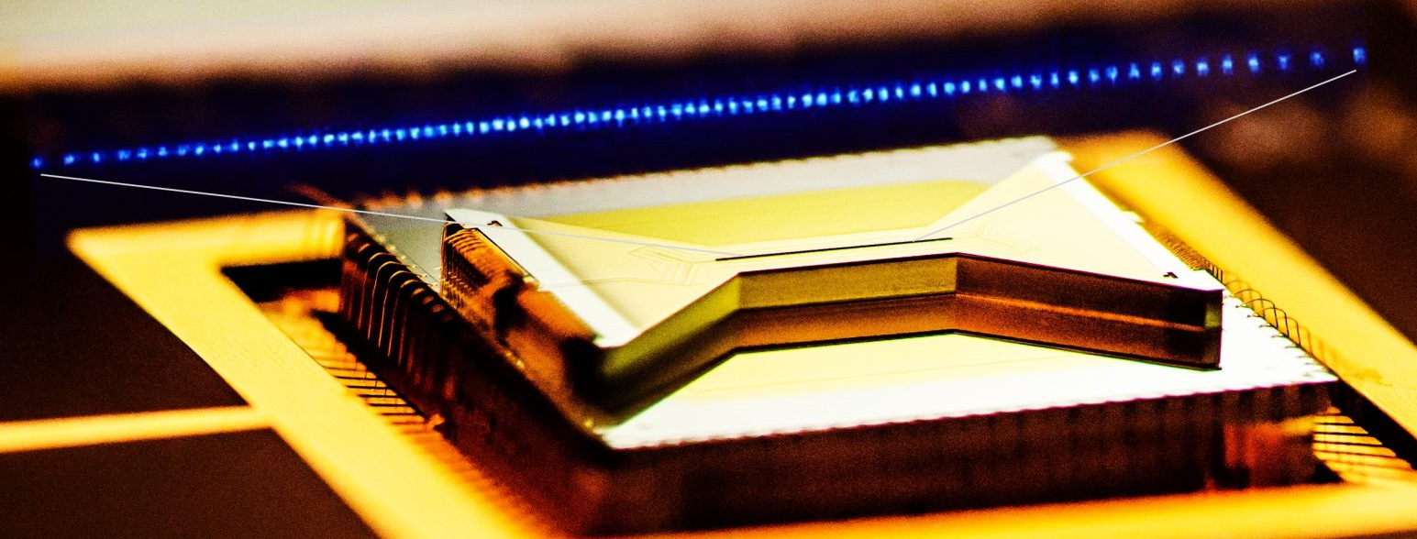
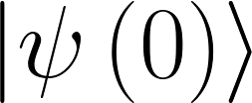
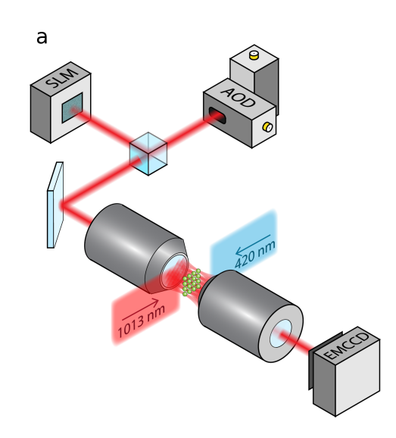
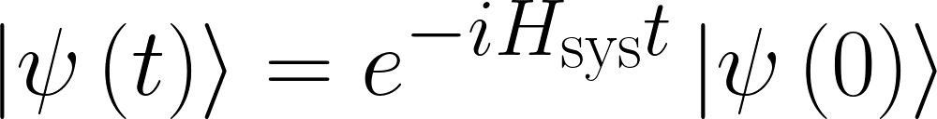
Variational Quantum Simulation: why?
There are two kinds of approaches:
Analog Quantum Simulators
They mimic a target Hamiltonian using a controllable system.
Prepare the initial state:
Let it evolve:
Measure and compute (ground state energy, correlation functions…)
Ultracold atoms in optical lattices
(Bloch’s Group at MPQ)
The calculations are more resilient to noise and errors
You need to engineer the simulated interactions
Trapped ions (Monroe’s Group at Duke)
Neutral atoms in tweezer arrays
(Lukin’s Group at Harvard)

Slide 8
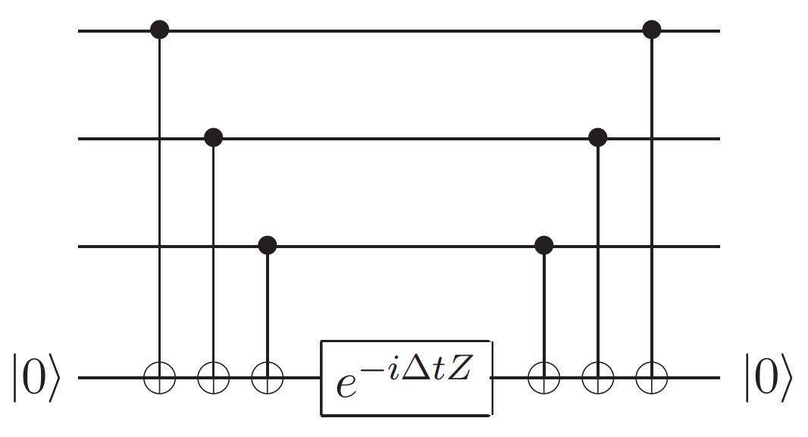
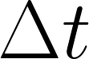
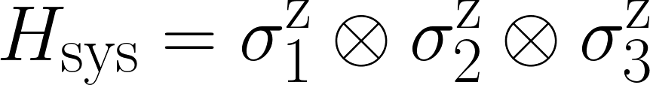
Variational Quantum Simulation: how?
There are two kinds of approaches:
Digital Quantum Simulators
They implement a quantum circuit (ultimately decomposed in single and two qubit gates).
You can simulate any kind of Hamiltonian: universal
Different types of algorithms: phase estimation, product formulas, quantum walks, Taylor series, quantum signal processing…
A. M. Childs et al., Toward the first quantum simulation with quantum speedup, PNAS 115 (38) 9456-9461 (2018)
A. M. Childs, Lecture Notes on Quantum Algorithms (2022).
Circuit to simulate the Hamiltonian
for a time
[from Quantum Computation and Quantum Information, Nielsen & Chuang (2000)].

Slide 9
Variational Quantum Simulation: how?
There are two kinds of approaches:
Digital Quantum Simulators
They implement a quantum circuit (ultimately decomposed in single and two qubit gates).
You can simulate any kind of Hamiltonian: universal
For most cases of interest, fault tolerance is needed
Current quantum computers are noisy, small and in general cannot be error-corrected
A. M. Childs et al., Toward the first quantum simulation with quantum speedup, PNAS 115 (38) 9456-9461 (2018)
Circuit to simulate the Hamiltonian
for a time
[from Quantum Computation and Quantum Information, Nielsen & Chuang (2000)].

Slide 10
Variational Quantum Simulation: how?
There are two kinds of approaches:
Digital Quantum Simulators
They implement a quantum circuit (ultimately decomposed in single and two qubit gates).
To (partially) mitigate the impact of errors, variational quantum algorithms were introduced.
You can simulate any kind of Hamiltonian: universal
For most cases of interest, fault tolerance is needed
Generate a parametrized quantum circuit.
Measure its output and use it to calculate a given cost function.
Approach its minimum using a classical optimizer.
Repeat until convergence.
The optimizer helps with limited hardware: useful for NISQ devices

Slide 11
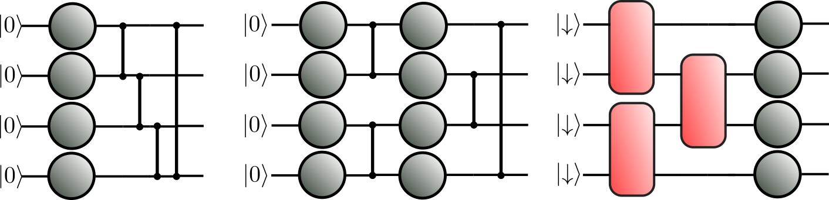
Variational Quantum Simulation: how?
There are two kinds of approaches:
Digital Quantum Simulators
They implement a quantum circuit (ultimately decomposed in single and two qubit gates).
To (partially) mitigate the impact of errors, variational quantum algorithms were introduced.
You can simulate any kind of Hamiltonian: universal
For most cases of interest, fault tolerance is needed
The optimizer helps with limited hardware: useful for NISQ devices

Slide 12
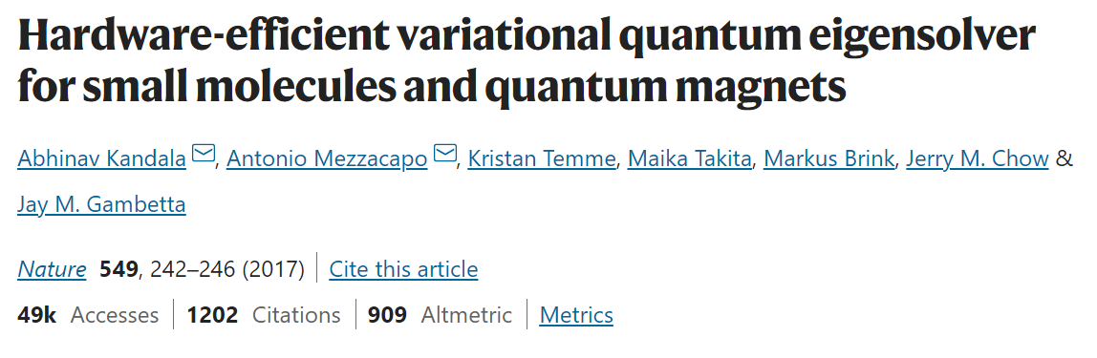
Variational Quantum Simulation: how?
There are two kinds of approaches:
Digital Quantum Simulators
They implement a quantum circuit (ultimately decomposed in single and two qubit gates).
To (partially) mitigate the impact of errors, variational quantum algorithms were introduced.
You can simulate any kind of Hamiltonian: universal
For most cases of interest, fault tolerance is needed
The optimizer helps with limited hardware: useful for NISQ devices

Slide 13
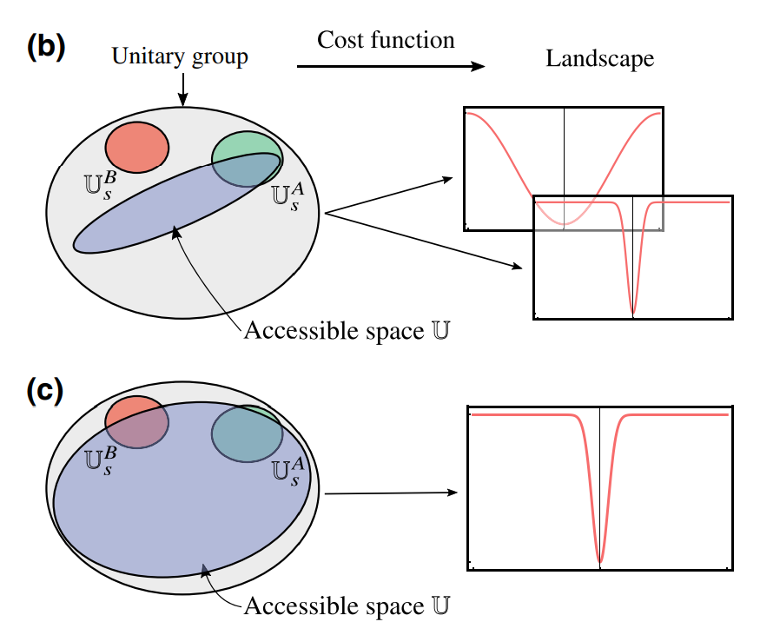
Variational Quantum Simulation: how?
There are two kinds of approaches:
Digital Quantum Simulators
They implement a quantum circuit (ultimately decomposed in single and two qubit gates).
To (partially) mitigate the impact of errors, variational quantum algorithms were introduced.
You can simulate any kind of Hamiltonian: universal
For most cases of interest, fault tolerance is needed
The optimizer helps with limited hardware: useful for NISQ devices
The optimization can be extremely challenging for “big” systems

Slide 14
Variational Quantum Simulation: how?
There are two kinds of approaches:
Digital Quantum Simulators
They implement a quantum circuit (ultimately decomposed in single and two qubit gates).
To (partially) mitigate the impact of errors, variational quantum algorithms were introduced.
You can simulate any kind of Hamiltonian: universal
For most cases of interest, fault tolerance is needed
Original: McClean et al., Nature communications 9, 4812 (2018).
Cost functions: Cerezo et al., Nature communications 12, 1791 (2021).
Noise: Wang et al., Nature communications 12, 6961 (2022).
Expressibility: Holmes et al., PRX Quantum 3, 010313 (2022).
The optimization can be extremely challenging for “big” systems

Slide 15
Overview
Variational Quantum Simulation: why and how?
Proposed as tool to get the most of current quantum simulators
The optimization is difficult (barren plateaus and local minima)
Some workarounds: natural gradients and variational recompilation
Hands on workshop
Natural gradients with Pennylane
Improving the simulations with tensor networks

Slide 16
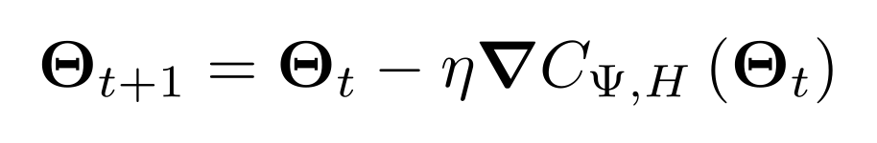
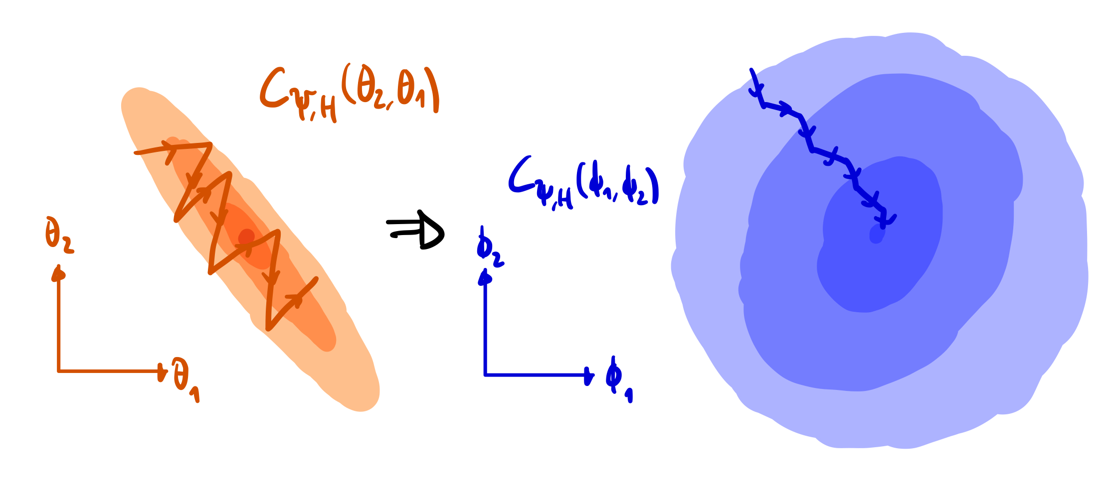
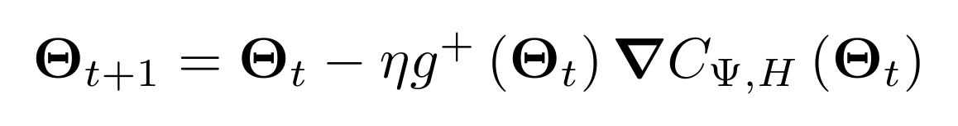
Variational Quantum Simulation: how?
How do you optimize a quantum circuit? With a natural gradient.
Gradient Descent
Generate a parametrized quantum circuit.
Measure its output and use it to calculate a given cost function.
Approach its minimum using a classical optimizer.
Repeat until convergence.
Quantum Natural Gradient Descent
J. Stokes et al., Quantum 4, 269 (2020)
N. Yamamoto, arXiv:1909.05074

Slide 17
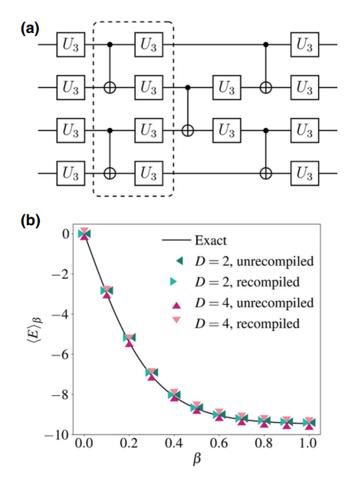
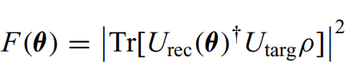
Variational Quantum Simulation: how?
It is not clear yet wheter variational quantum algorithms may offer any advantage. Is this the end of the story?
Variational Circuit Recompilation
Generate a parametrized quantum circuit.
Measure its output and use it to calculate a given cost function.
Approach its minimum using a classical optimizer.
Repeat until convergence.
Shi-Ning Sun et al., PRX Quantum 2, 010317 (2021)

Slide 18
Quantum simulation: how?
In summary:
Analog Quantum Simulators
Mimic a target Hamiltonian using a controllable system.
Digital Quantum Simulators
Quantum-classical variational quantum algorithms were introduced to compensate for errors.
You can simulate any kind of Hamiltonian: universal
For most cases of interest, fault tolerance is needed
The calculations are more resilient to noise and errors
You need to engineer the simulated interactions
The optimizer helps with limited hardware: useful for NISQ devices
The optimization can be extremely challenging for “big” systems
What about a mix? Variational analog quantum simulation

Slide 19
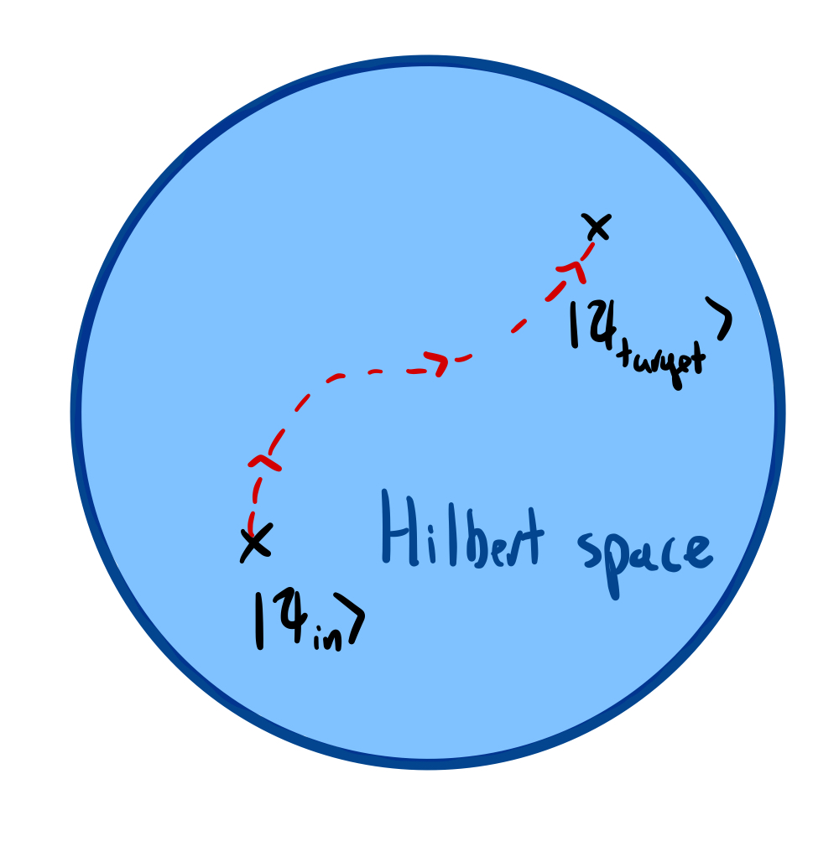
Quantum simulation: how?
Variational analog quantum simulators combine the strengths of both approaches.
Native many-body entangling operations easily provide large-scale entanglement.
Some digital operations can be included to increase the tunability.
The classical optimization loop allows an efficient use of the quantum resources available.
R. Kaubruegger et al., Phys. Rev. Lett. 123, 260505 (2019)
C. Kokail et al., Nature 569, 355–360 (2019)
R. Kaubruegger et al., Phys. Rev. X 11, 041045 (2021)
C. Tabares et al., Phys. Rev. Lett. 131 073602 (2023)

Slide 20
Conclusions
Variational Analog Quantum Simulators are a promising approach to obtain practical quantum advantage
The variational loop is limited by barren plateaus and local minima: we need to overcome them.
General variational quantum algorithms may not be practical, but there are workarounds: natural gradients, recompilations…
Do you know any interesting physics or model that you think
could be (partially) understood with a variational algorithm?
Or any particular platform where this ideas may be useful?
Please let me know :)

Slide 21
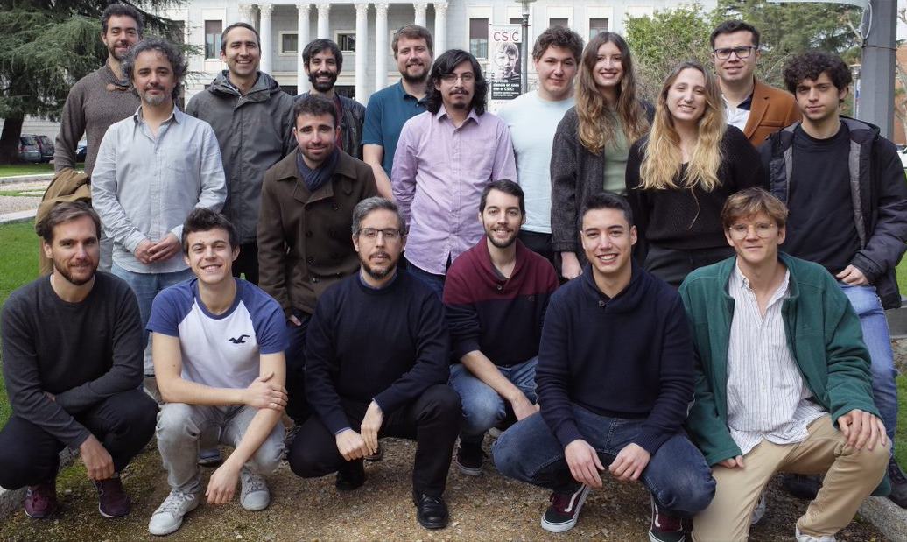



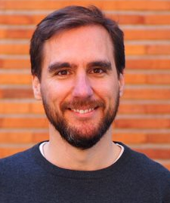
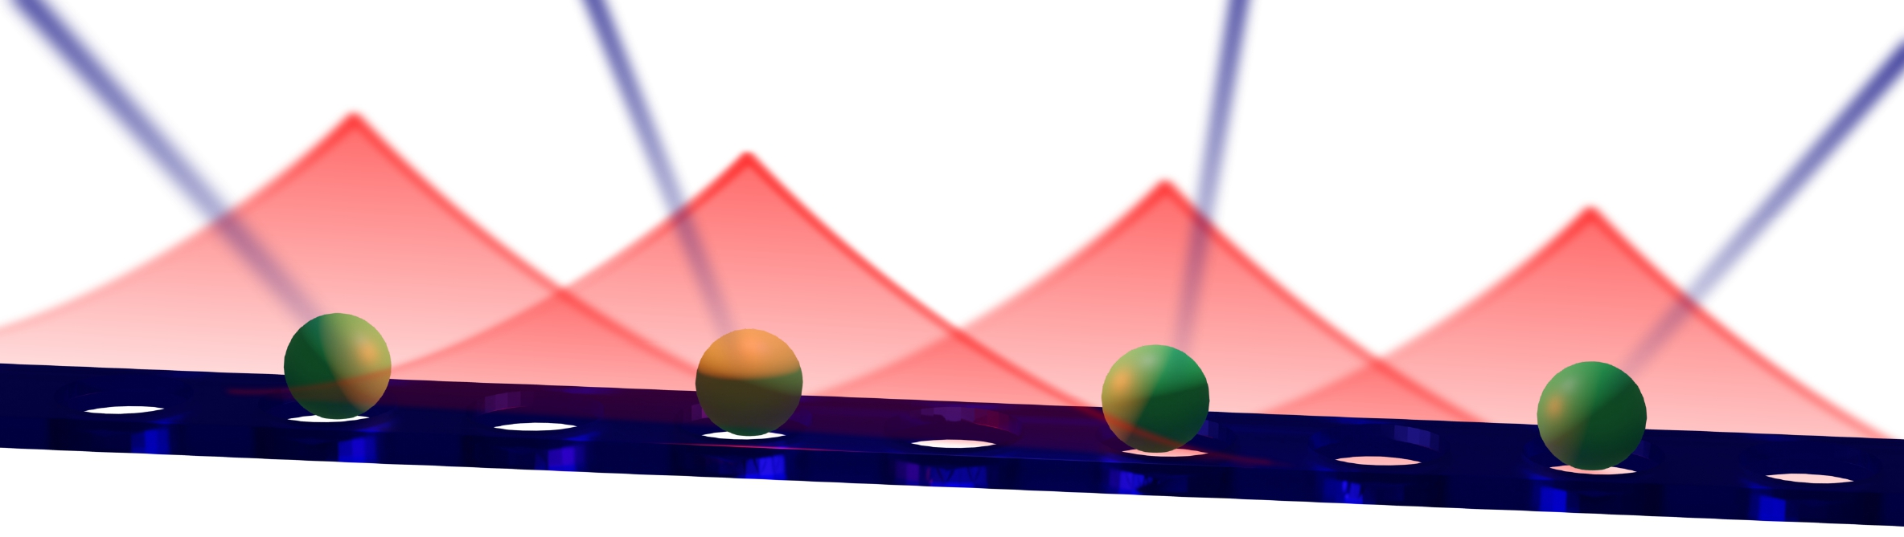


Thank you for your attention!
Work done in collaboration with:
Alberto Munoz de las Heras
Luca Tagliacozzo
Diego Porras
Alejandro Gonzalez-Tudela
at QUINFOG (IFF-CSIC, Madrid)
arXiv:2302.01922
Cristian Tabares
@T_L_Cris
cristiantabares.xyz
cristian.tabares@csic.es

